Slide 1
Coefficient Path Algorithms
Karl Sjöstrand
Informatics and Mathematical Modelling, DTU

Slide 2
What’s This Lecture About?
The focus is on computation rather than methods.
Efficiency
Algorithms provide insight

Slide 3
Loss Functions
We wish to model a random variable Y by a function of a set of other random variables f(X)
To determine how far from Y our model is we define a loss function L(Y, f(X)).

Slide 4
Loss Function Example
Let Y be a vector y of n outcome observations
Let X be an (n×p) matrix X where the p columns are predictor variables
Use squared error loss L(y,f(X))=||y -f(X)||²
Let f(X) be a linear model with coefficients β, f(X) = Xβ.
The loss function is then
The minimizer is the familiar OLS solution

Slide 5
Adding a Penalty Function
We get different results if we consider a penalty function J(β) along with the loss function
Parameter λ defines amount of penalty

Slide 6
Virtues of the Penalty Function
Imposes structure on the model
Computational difficulties
Unstable estimates
Non-invertible matrices
To reflect prior knowledge
To perform variable selection
Sparse solutions are easier to interpret

Slide 7
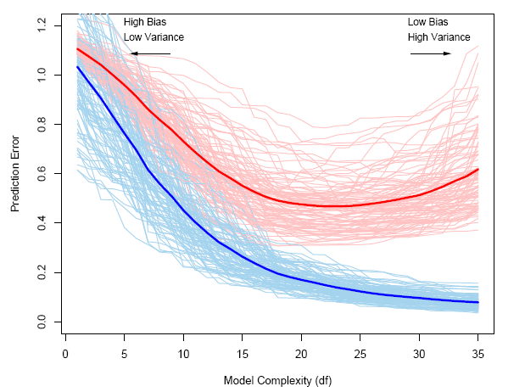
Effect of the Penalty
We prefer simple (interpretable) model with stellar performance
Are these properties contradictory?
Yes – and no.
Image from Elements of Statistical Learning

Slide 8
Selecting a Suitable Model
We must evaluate models for lots of different values of λ
For instance when doing cross-validation
For each training and test set, evaluate for a suitable set of values of λ.
Each evaluation of may be expensive

Slide 9
Topic of this Lecture
Algorithms for estimating for all values of the parameter λ.
Plotting the vector with respect to λ yields a coefficient path.

Slide 10
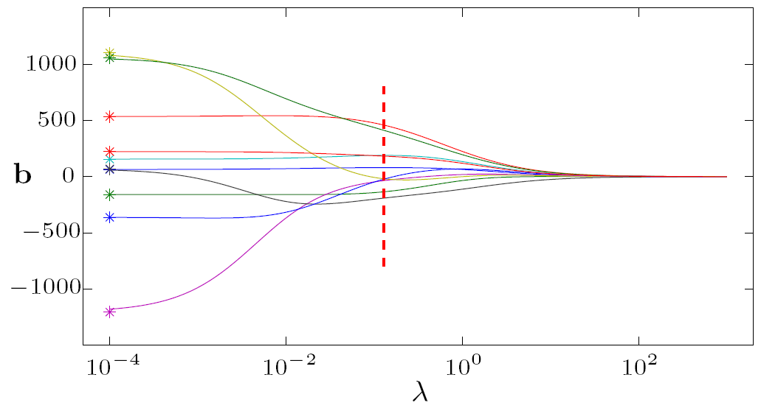
Example Path – Ridge Regression
Regression – Quadratic loss, quadratic penalty

Slide 11
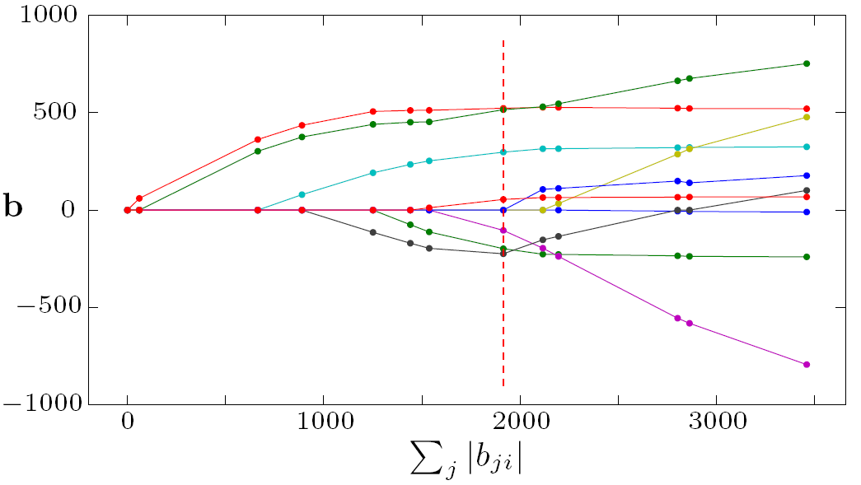
Example Path - LASSO
Regression – Quadratic loss, piecewise linear penalty

Slide 12
Example Path – Support Vector Machine
Classification – details on loss and penalty later

Slide 13
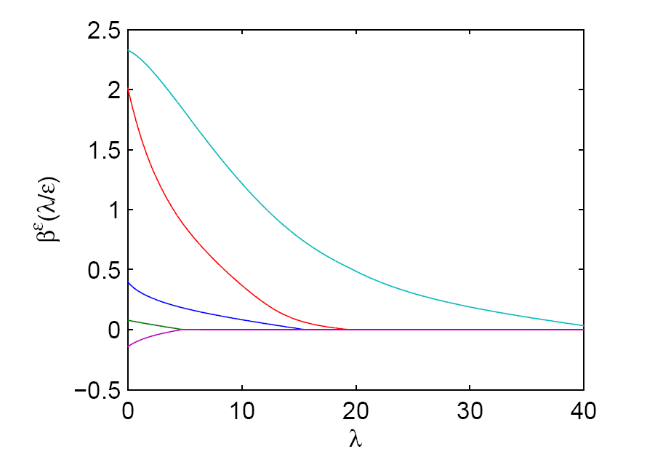
Example Path – Penalized Logistic Regression
Classification – non-linear loss, piecewise linear penalty
Image from Rosset, NIPS 2004

Slide 14
Path Properties

Slide 15
Piecewise Linear Paths
What is required from the loss and penalty functions for piecewise linearity?
One condition is that is a piecewise constant vector in λ.

Slide 16
Condition for Piecewise Linearity

Slide 17
Tracing the Entire Path
From a starting point along the path (e.g. λ=∞), we can easily create the entire path if:
is known
the knots where change can be worked out

Slide 18
The Piecewise Linear Condition

Slide 19
Sufficient and Necessary Condition
A sufficient and necessary condition for linearity of at λ₀:
expression above is a constant vector with respect to λ in a neighborhood of λ₀.

Slide 20
A Stronger Sufficient Condition
...but not a necessary condition
The loss is a piecewise quadratic function of β
The penalty is a piecewise linear function of β
constant
disappears
constant

Slide 21
Implications of this Condition
Loss functions may be
Quadratic (standard squared error loss)
Piecewise quadratic
Piecewise linear (a variant of piecewise quadratic)
Penalty functions may be
Linear (SVM ”penalty”)
Piecewise linear (L₁ and L_{inf})

Slide 22
Condition Applied - Examples
Ridge regression
Quadratic loss – ok
Quadratic penalty – not ok
LASSO
Quadratic loss – ok
Piecewise linear penalty - ok

Slide 23
When do Directions Change?
Directions are only valid where L and J are differentiable.
LASSO: L is differentiable everywhere, J is not at β=0.
Directions change when β touches 0.
Variables either become 0, or leave 0
Denote the set of non-zero variables A
Denote the set of zero variables I

Slide 24
An algorithm for the LASSO
Quadratic loss, piecewise linear penalty
We now know it has a piecewise linear path!
Let’s see if we can work out the directions and knots

Slide 25
Reformulating the LASSO

Slide 26
Useful Conditions
Lagrange primal function
KKT conditions

Slide 27
LASSO Algorithm Properties
Coefficients are nonzero only if
For zero variables
A
I

Slide 28
Working out the Knots (1)
First case: a variable becomes zero (A to I)
Assume we know the current and directions

Slide 29
Working out the Knots (2)
Second case: a variable becomes non-zero
For inactive variables change with λ.
Second added
variable
algorithm direction

Slide 30
Working out the Knots (3)
For some scalar d, will reach λ.
This is where variable j becomes active!
Solve for d :

Slide 31
Path Directions
Directions for non-zero variables

Slide 32
The Algorithm
while I is not empty
Work out the minmal distance d where a variable is either added or dropped
Update sets A and I
Update β = β + d
Calculate new directions
end

Slide 33
Complexity
Roughly O(n²p)
About the same complexity as for a single least-sqares fit

Slide 34
Variants – Huberized LASSO
Use a piecewise quadratic loss which is nicer to outliers

Slide 35
Huberized LASSO
Same path algorithm applies
With a minor change due to the piecewise loss

Slide 36
Variants - SVM
Dual SVM formulation
Quadratic ”loss”
Linear ”penalty”

Slide 37
A few Methods with Piecewise Linear Paths
Least Angle Regression
LASSO (+variants)
Forward Stagewise Regression
Elastic Net
The Non-Negative Garotte
Support Vector Machines (L1 and L2)
Support Vector Domain Description
Locally Adaptive Regression Splines

Slide 38
References
Rosset and Zhu 2004
Piecewise Linear Regularized Solution Paths
Efron et. al 2003
Least Angle Regression
Hastie et. al 2004
The Entire Regularization Path for the SVM
Zhu, Rosset et. al 2003
1-norm Support Vector Machines
Rosset 2004
Tracking Curved Regularized Solution Paths
Park and Hastie 2006
An L1-regularization Path Algorithm for Generalized Linear Models
Friedman et al. 2008
Regularized Paths for Generalized Linear Models via Coordinate Descent

Slide 39
Conclusion
We have defined conditions which help identifying problems with piecewise linear paths
...and shown that efficient algorithms exist
Having access to solutions for all values of the regularization parameter is important when selecting a suitable model

Slide 40
Questions?
Later questions:
Karl.Sjostrand@gmail.com or
Karl.Sjostrand@EXINI.com

